Slide 1


DAY 3
Advanced C programming

Slide 2
TODAY’S OUTLINE
POINTERS IN C
TRANSITION FROM C TO C++

Slide 3
POINTERS
variable which holds the ADDRESS
of another variable

Slide 4
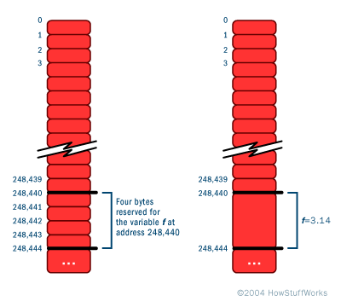
Understanding Memory Addresses
All computers have memory, also known as RAM (random access memory). For example, your computer might have 1 or 2 or 4 gigabytes of RAM installed right now.
Memory can be thought of simply as an array of bytes. In this array, every memory location has its own address -- the address of the first byte is 0, followed by 1, 2, 3, and so on.

Slide 5

DECLARATION AND INITIALIZATION
int x, y, *p;
x=10;
p=&x;
y=*p;
printf(“ %d is stored at addr %u\n” ,x, &x);
printf(“%d is stored at addr %u\n”,*&x,&x);
printf(“%d is stored at addr %u\n”,*p,p);
printf(“%d is stored at addr %u\n”,p,&p);
printf(“%d is stored at addr %u\n”,y,&y);
pointer declaration
pointer initialization
10 is stored at addr 4104
10 is stored at addr 4104
10 is stored at addr 4104
4104 is stored at addr 4106
10 is stored at addr 4108

Slide 6
CHAIN OF POINTERS
int x,*p1,**p2;
x=100;
p1=&x; /* address of x */
p2=&p1; /*address of p1 */
printf(“%d”,**p2); /* 100 */
p2 p1 variable
Address 2
Address 1
value

Slide 7
POINTER EXPRESSIONS
Like other variables pointers can also be used in expressions.
Y=*p1*p2; same as (*p1)*(*p2)
Sum=sum+*p1;
Z=5*-*p1/*p2; same as (5*(-(*p2)))/(*p1)
If p1 and p2 are pointers of the same array then p2-p1 gives the number of elements between p1 and p2
p1/p2 or p1*p2 or p1+p2 are illegal.

Slide 8
POINTERS AND ARRAYS
1 | 3 | 2 | 6
1000 1002 1004 1006
p=&x[0]; =(1000)
p+1=&x[1]; =(1002)
p+2=&x[2]; =(1004)
p+3=&x[3];=(1006)
Address of x[3]=base address+ (3*scale factor of int)=1006
int *p, sum=0, i;
int x[4]={1,3,2,6};
p=x;
for(i=0;i<4;i++)
{
printf(“x[%d] %d %u\n”,i,*(p+i),(p+i));
sum=sum+*(p+i);
}
printf(“%d\n”,sum); /* 12 */

Slide 9
Migrating from C to C++

Slide 10
Why C++ ?
A better ‘C’.
You don’t need to put all declarations at the top of each block
Stronger Type Checking
Object Oriented Features
Operator Overloading, Exception Handling
Backward Compatible with ANSI C
Bigger Standard Template Library
Rich collection of 3rd party libraries
Qt, Boost, Wt, ACE

Slide 11
Why C++ ?
The choice of language for competitive coding
Faster than Java and as fast as C
STL provides the luxury of focusing more on the problem rather than the underlying implementation.
Built-in algorithms and Data Structures

Slide 12
Moving to C++
Get comfortable with C
Slowly start migrating to C++
C code is fully compatible with C++
Keep solving at some online judge
Reference
cplusplus.com
Thinking in C++, Bruce Eckel
The C++ Programming Language, Bjarne Stroustrup

Slide 13
An Example (C vs C++)
C | C++
#include<stdio.h> int main() { int i,j; scanf(“%d %d”, &i, &j); printf(“%d + %d = %d\n”, i, j, i+j); return 0; } | #include<iostream> using namespace std; int main() { int i,j; cin>>i>>j; cout<<i<<“+”<<j<<“=“<<i+j<<“\n”; return 0; }

Slide 14
That’s all folks !!!
☺

